Slide 1
Evidence-Based National Policies: Significance and Implications
John Carnevale, Ph.D.
Carnevale Associates, LLC
John@carnevaleassociates.com
Presentation to the Inter-American Drug Abuse Commission
Fifty-First Regular Session
May 9-11, 2012
Washington, DC
Notes:
There is a substantial literature on evidence-based policies that has emerged from the United Kingdom and Australia. See, for example, Gary Banks, “Challenges of Evidence-based Policy-Making”, Australian Government, Productivity Commission, Australian Public Service Commission, 2009; or Head, B. W. 2008, “Three Lenses of Evidence-based Policy”, Australian Journal of Public Administration, Vol. 67. No. 1, pp. 1-11, or Cummins, Jim, “Putting the Evidence Back into Evidence-based Policies for Underachieving students”, The University of Toronto, presented to the Language Policy Division, Directorate of Education and Languages, DGIV, Council of Europe, Strasbourg, January 2011.
The objective of the CICAD panel on this topic is: discuss with the national drug Commissioners the importance and relevance of evidence-based drug policy, in its formulation, monitoring, and evaluation, and how this policymaking method is more efficient than methods that do not utilize such evidence. To demonstrate the latter theme would require a benefit-cost analysis comparing countries that do use evidence versus those that do not; such an analysis is not possible.
However, we can speculate about the relative benefits of obtaining and using evidence relative to the societal cost imposed by a drug problem—I will do that at the end of this presentation.

Slide 2
What is a Policy?
A policy is nothing more than a course of action selected from among alternative actions to guide present and future decisions.
2
Notes:
Let’s start with a common understanding of the meaning of the word “policy.”

Slide 3
What Constitutes Evidence?
Evidence constitutes published and existing research; good data from surveys; expert knowledge; past experience.
It is derived from a sound, valid, and reliable methodology that allows for a practical consideration of the nature of the issue or problem.
It can withstand public scrutiny; it is transparent.
It comes from individuals skilled in quantitative methods.
3
Notes:
Next, let’s define what we mean when we use the word “evidence.” What meaning does this have to a policy maker?

Slide 4
What is an Evidence-based Policy?
It is simply a policy based on evidence.
It is NOT policy based on ideology, conventional wisdom, or intuition.
Country A
Ideology, Intuition, Conventional Wisdom
Country B
Evidence
4
Notes:
This slide shows that different countries may set policy based on different levels of evidence. It use the economist tool—the production possibilities curve—to show how there is a tradeoff between the level of evidence and the ideology/intuition/conventional wisdom that is shaping the policy. Presumably, over time, as evidence becomes available, a country’s capacity to develop an evidence-based policy is greater (e.g., Country B). But, while making policy based on evidence seems to be an obvious desire, there are practical problems in implementing evidence-based policies. We will turn to that now.

Slide 5
What are the Challenges in
Implementing Evidence-based Policies?
Making a policy based on evidence should be obvious, but there are practical challenges:
The fluid nature of the policy formulation process.
Confusion about how the policy & budget formulation process works.
Confusion about when and how evidence should enter the policy formulation process.
Competing interests/priorities—not all policy issues can get equal standing in government decisions.
Resource constraints limit implementation of evidence-based policies.
Evidence is never complete or adequate enough.
Evidence may stand in the way of ideology/politics.
Conventional Wisdom
Habits & Tradition
Ideology
Budget Realities
Evidence
Intuition/
Opinion
Lobbyists & Interest Groups
Politics
5
Notes:
Adapted/Modified from Davies, P. (2004), Policy Evaluation in the United Kingdom. Based on his lecture presented at the 4th annual Campbell Collaboration Colloquium.
In the real world, policy is developed in a fluid environment that is subject to competing interests, lack of understanding of the policy/budget formulation cycle, confusion about how to express research/data in ways that can accommodate the policy formulation process, ideology, and so forth. Drug policy is a complex issue and what we know about the main ingredients of a drug policy—prevention, treatment, interdiction, law enforcement, and international programs—is not equally weighted by the evidence nor is our knowledge of the myriad programs that can be implemented within each “ingredient” area.
Why does evidence not get used? 1) Wrong answers! (runs counter to conventional wisdom). 2) wrong time (before or after an election!!!) 3) wrong place (harm reduction in a country that seeks abstinence based solutions driven by ideologies) 4) picks someone else’s pocket 5) you get it………..

Slide 6
How Does This Link to
Drug Policy?
Outcomes or Impacts
Sought in 3 Areas
5 Main Ingredients
2 Categories
Prevention
Drug Use
Consequences
Availability
Demand
Treatment
Reduction
Interdiction
Supply
International
Reduction
Domestic Law
Enforcement
6
Notes:
What is the role of evidence in informing drug policy? It is to inform policy, program, and budget managers about the best course of action to address the underlying drug problem identified from an evidence-based needs assessment.
Research has taught us a lot about the key ingredients that typically comprise a country’s drug control strategy, but that knowledge or evidence is uneven. The difference between having evidence and not having it is that decision makers can make more informed decisions about the correct “mix” of ingredients based on evidence; otherwise they have to rely on theory, ideology, opinion, or experience to decide the best course of action. They may a good decision; they may not. Resources may be spent efficiently; they may not.
What do we know about the strength of the evidence with regard to the choice of the ingredients? Research shows that treatment and prevention programs are very effective in reducing drug demand, saving lives, and lessening associated damaging health and crime consequences. It has also found that attacking drugs at their source—essentially eradication—is not effective; as long as there is a demand for drugs, there will be a supply. Research shown that drug interdiction programs can temporarily lessen the ability of drug traffickers to bring their product to the market, but there long-run value is quite low. We know that certain aspects of law enforcement are significant (e.g., community policing, drug courts) but we know little about the effectiveness of laws passed to address demand or supply or other aspects of the Criminal Justice system (corrections). If research were our guide, then one would expect that countries would place much more emphasis on demand reduction programs over supply reductions, but both sets of ingredients would be somehow represented.

Slide 7
How Does Evidence-based Policy
Link to the CICAD Policy Framework?
Community: The Constituent elements that have a stake in the pursuit
Strategy: Mechanism that allows Goals to be pursued
Evaluation: Mechanism that guides the pursuit; research and evaluation; feedback loop provided through Performance Measurement
Budget: Mechanism that allows resources to be used for the pursuit of goals and objectives
Community
Strategy
Evaluation
Budget
See CICAD’s Guide, “How to Develop a National Drug Policy: A Guide for Policymakers, Practitioners, and Stakeholders” 2009
Notes:
This is the framework presented in CICAD’s 2009 Guide: It is offered as a tool to help countries develop evidenced based drug policies.
Goals define the major directives or directions of the Substance Abuse Strategy
Objectives define major lines of action to achieve each strategic goal.
Targets define desired end states/results against which to compare actual performance.
Measures are the data, variables and events used to track progress toward the targets.

Slide 8
Community
Evidence: Research and data systems are key and evidence is strong. Good research on evidence-based programs exists and knowledge of what data systems provide the best evidence to inform policy formulation:
  There are many examples of comprehensive data systems that can inform stakeholders about the nature and extent of a country’s drug problem (in the areas of drug use, drug use health and crime consequences, societal costs) .
  There are well documented methods about how best to analyze data for purposes of informing policy
  There are well documented methods about how to define the community of stakeholders who should be engaged in a comprehensive, evidence-based needs assessment.
Community
(Assess Problem)
Strategy
(Guide)
Evaluation
(Evaluate)
Budget
(Implement)
8
Notes:
In formulating a drug control strategy, the evidence shows that a nation should first start by identifying and bringing together the relevant stakeholders, or the constituent elements, that have a stake in efforts to solve the country’s drug problem. Once together, they should conduct a needs assessment that digests data describing all aspects of the drug problem. They should also review the evidence from research about the relative effectiveness of various approaches to addressing their drug problem.

Slide 9
Strategy (The Guide)
Evidence: There is a substantial body of work about how to design or structure a country’s drug control strategy in a way that will inform program and budget decisions—the evidence is strong:
  CICAD’s Guide “How to Develop a National Drug Control Policy” is one of many examples .
  The knowledge base about establishing goals and objectives to direct supply reduction and demand reduction activities is extensive.
  Likewise, there is a literature and decades of country-level experience about setting impact targets (the ultimate results sought by a country’s drug control strategy).
Community
(Assess Problem)
Strategy
(Guide)
Evaluation
(Evaluate)
Budget
(Implement)
9

Slide 10
Budget
Community
(Assess Problem)
Strategy
(Guide)
Evidence: The evidence is weak about how best to account for drug control spending. There are no standards from research. We rely on country examples:
  Drug budget accounting appears simple, but can be difficult. Direct program spending is easily counted (e.g., funding for a drug task force targeting drug trafficking organizations) , but indirect spending is not (a “wellness” program that promotes healthy life choices among youth is more than drug prevention).
  Problems in accounting for non-government expenditures (e.g., workplace prevention).
Evaluation
(Evaluate)
Budget
(Implement)
10
Notes:
Budget refers to the resources that are required to implement a country’s drug strategy. Accounting for drug control expenditures is more of an art than a science. There are no standards—nationally or internationally—for accounting for drug related spending. Most countries count direct government expenditures that are exclusively for drug control purposes, but there are no accepted methodologies for counting spending for those programs that exceed drug control activities (this is particularly true for areas like youth prevention, community policing, and general health-oriented programs).

Slide 11
Policy Evaluation
Community
(Assess Problem)
Strategy
(Guide)
Evidence: The evidence is strong about methods used to monitor and evaluate the effectiveness and impact of a country’s drug control strategy:
  Evaluation includes monitoring routine data collected on various factors (e.g., behaviors, drug prevalence, drug –related crime) that can be used for analysis.
  Evaluation is the systematic assessment if an ongoing or completed project, program, or strategy in achieving its expected results.
  Monitoring and evaluation are critical management tools .
  Extensive literature and country-level experience is available.
Evaluation
(Evaluate)
Budget
(Implement)
11
Notes:
Evaluation provides a means to monitor and assess the implementation and effectiveness of a country’s national drug control strategy. It’s usefulness really lies in its ability to inform stakeholders of their progress in achieving strategic goals and objectives of the Strategy. It also informs them of the effectiveness of specific programs that were selected to implement the strategy (program evaluation) as well as the changing nature of the underlying drug problem (from monitoring drug abuse and market trends) to drive adjustments to the Strategy.
The CICAD Guide is a good general resource for countries to use in building effective evaluation systems. There is also a vast literature supported by numerous country examples of performance monitoring.

Slide 12
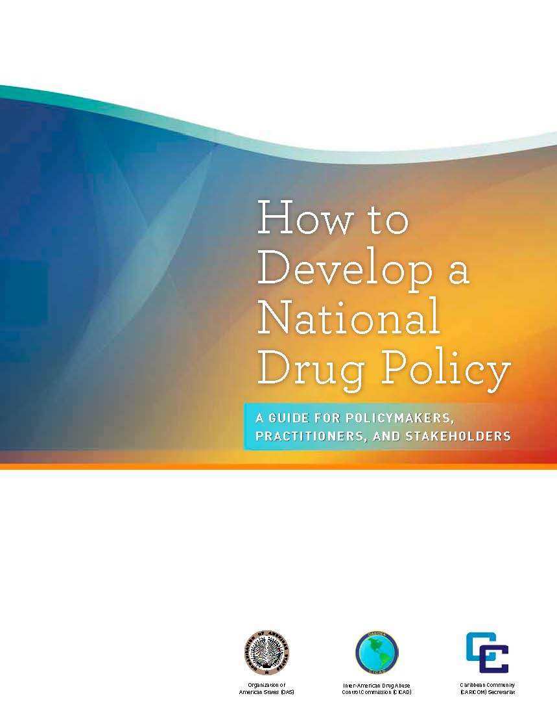
CICAD Guide: Reference Source
12
Notes:
Closing comment about the worth of making expenditures to obtain evidence to inform drug policy relative to its cost:
I will use the United States as an example, simply because I know the drug policy model in the U.S. the best.
What is the ratio of the cost of obtaining evidence relative to the societal cost of the drug problem in the United States? Let’s start with the easiest part…….the societal cost of drug abuse. It is easy to estimate only because my firm just completed a study estimating the societal cost of drug abuse in the United States for the National Drug Intelligence Center. See http://www.justice.gov/ndic/pubs44/44731/44731p.pdf. That study estimated societal costs to total $193 billion in 2007. This is the denominator for our calculation.
What does the U.S. spend on research and data systems in a year. We don’t know for sure, but the drug czar’s budget tell us the following: We spend 1 billion for the National Institute for Drug Abuse, $0.4 billion for National Institute on Alcohol Abuse and Alcoholism, about $20 million on criminal Justice research at the National Institute on Justice, about $200 million for data surveillance systems at SAMHSA; we don’t know what the CDC spends for drug programs or what BJS spends nor do we know what other governments or the private sector (including foundations) spend. Thus far we have about $1.6 billion. Let’s assume that we are off by a factor of ten (to represent all government and non-government spending), then our estimate is about $16 billion.
The ratio of $16 billion to $193 billion is 8.3. In other words, the cost of drug-related research and data collection systems is about 8.2 percent of the total societal costs of drug abuse in the U.S. per year. If it were 20 percent, would it be worth it? This question is a policy one for you to consider, but the cost relative to the cost of the problem seems small.

